Slide 1
A Basic Intro to Gm/Id technique
Presented by Deepa Kulkarni
Guided by Neeraj Mishra, BITS Pilani

Slide 2
Presentation topics
Introduction
Big picture
Long-channel method
The Vov-Based Design Methodology
Limitations of the Vov-based design.
The gm/ID-Based Design Methodology
A deeper understanding of gm/ID technique.
Conclusion

Slide 3
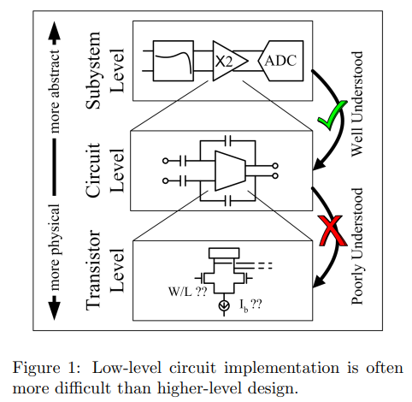
Introduction
CMOS behavior is hard to predict without complex models, and this problem gets worse as technology scales down.
Designers get stuck in hand calculations and endless simulations.
Author's goal
  gm /ID based design methodology improves the predictability of CMOS small-signal behavior without needing complex equations.
  Essentially, it serves as a bridge between the transistor's bias point and its small-signal model

Slide 4
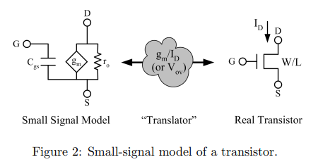
Big picture
Analog Design Relies on Abstraction
Higher-Level Design: involves using components like filters and amplifiers.
  it relies on linear Signals-and-Systems theory, which uses elegant and established mathematics.
Lower-Level Design: involves deciding on transistor sizes and bias currents.
  Building a gain stage of op-amp is easier than an opamp itself.
  WHY?
    Transistor behavior is nonlinear, linear analysis will not work.
    Technology changes too quickly, so there are no simple, accurate equations for transistors that are useful for both hand calculations and simulations.

Slide 5
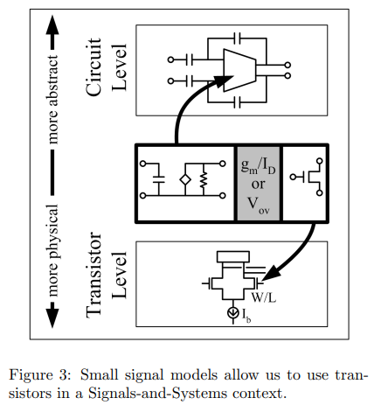
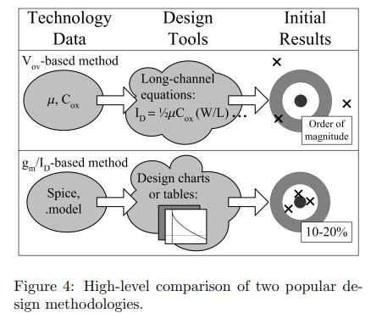
Making Low-Level Design Manageable:
Simplifying Design: To make low-level design easier, transistors are converted into Signals-and-Systems-friendly devices by using a small-signal model
  Mostly by assuming few ideal elements introducing errors.
  Signals and systems techniques allow the designer to analyze gain, BW, frequency response, poles, zeroes etc.
The Bridge: The gm /ID (or Vov ) acts as a "translator" or intermediate variable that connects the abstract-to-physical gap.

Slide 6
Why gm/ID is Better than Vov?
Vov -based and gm /ID -based design methodologies lies in their foundational principles and accuracy.
Vov -Based Design
This method relies on the long-channel model of a MOSFET, which is derived from simple calculus.
Assumptions for this model are no longer true for today's small transistor sizes.
To salvage the model, designers have tried to patch it with short-channel effects and curve-fitting terms etc., are harder and less accurate.
gm /ID -Based Design
This doesn't rely on the long-channel model ; but refers a look-up table.
It is data generated from accurate device simulations in Spice.
it provides initial designs close to the final target, needing only minor tweaks.

Slide 7
The more detailed picture
A First Attempt at Transistor-Level Design:
The end product in a circuit is basically a netlist: a list of all components (transistors, resistors, capacitors, etc.) and how they’re connected.
In SPICE, designing often comes down to choosing W and L for each transistor.
One way to choose these is: Pick a circuit topology ; Guess W, L (and any R, C); Simulate; Check if it meets specs; If not, change sizes and repeat.
This approach is called SPICE Monkeying. - slow and blind.
Solution?
Instead, use hand calculations with small-signal models to understand and predict behavior before simulating. - faster and smarter!

Slide 8
Long-Channel Model Review
Long-channel model: derivation might be over-simplified, but it provides a good starting point and intuition in predicting the circuits.
It describes the relationship between drain current Id and nodal voltages Vds & Vgs.
Vov is the overdrive voltage: Vov = Vgs-Vth.
  Vov tells how inverted the channel is.
  It is easier to work with than Vgs (hides dependency on Vth).
Inversion: Material in the channel starts behaving as the inverse of itself.
  A small Vov is weak inversion (low current).
  A large Vov is strong inversion (high current).
Regions of operation of MOSFET: Cutoff, Linear and Saturation.

Slide 9
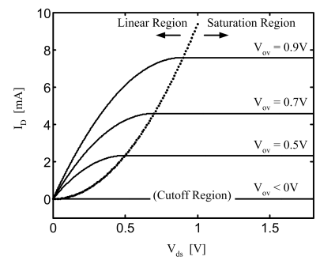



1. Cutoff Region
  Condition: Vov < 0 (or Vg< Vth).
  No channel inversion → ID = 0 (OFF state).
2. Linear Region
  Condition: Vov ≥ 0 and Vds < Vdsat.
  Channel inversion present, but ID depends strongly on Vds.
  Equation:
  The transistor is used as a switch in this region.
  The ON-resistance is
3. Saturation Region
Condition: Vov≥0 and Vds≥Vdsat.
ID becomes a function of the gate voltage Vov (not of Vds).
Most signal-path transistors are operated here.
For enough Headroom: Vds≥Vdsat; A saturation-type simulations are done.

Slide 10


The Vov-Based Design Methodology
Gm, ft and making sense of transistor-level design
We have to develop Vov into a design variable and link It with Small-signal model.
Gm is the slope of Id vs Voc curve. : and
  These equations give the idea of relationship between gm/Id and Vov.
  This defined tranconductor efficiency (mS/mA; same as gm/Id).
Interpretation: It tells you how much gm (in mS) you get when you invest a given ID (in mA).
  Higher gm → more gain.
  Increasing ID (for fixed Vov) increases gm.

Slide 11
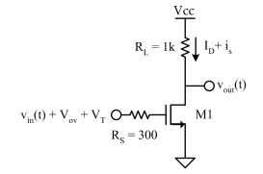
Example
Operate M1 with Vov of 300mV. Id=1mA.
Gm = 2Id/Vov = 6.7 mA/V
Vout/vin = -6.7 V/V
We use ID to alter the gain. Double the Id to obtain the gain.
  Gm = 2Id/Vov = 13.4 mA/V
  Vout/vin = -13.4 V/V
  Notice: Vov is kept constant, gain is changed by adjusting Id.
Gm= 2Id/Vov
  Very small Vov → very high gm → seemingly infinite efficiency.
  A transistor with very small Vov will be slow.
  Trade-off: Small Vov increases efficiency but slows the transistor.

Slide 12
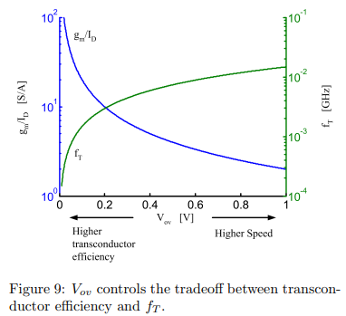


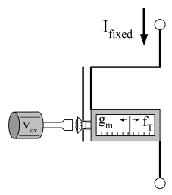
Speed in terms of Vov
Transit frequency definition: Measures transistor speed.
In saturation: Cgs ≈ (2/3) * Cox * W*L.
Using the long-channel model:
Therefore, we cannot make Vov arbitrarily small – because it limits speed.
Observations from gm vs ft tradeoff:
  Low Vov → high gm/ID (good efficiency) but low speed.
  High Vov → high speed (fT ) but lower efficiency.
Vov is a "knob" to balance gain (gm) vs. bandwidth (fT).
  For low power designs → pick lower Vov.
  For high-speed designs → pick higher Vov
  Analogy: Like a screwdriver — you turn Vov to decide how much of your current ID goes toward gain or speed.

Slide 13
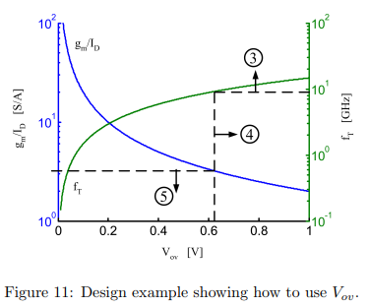
How to use Vov to alter gm or fT ?
We want a gain of 10 and a bandwidth of 500 MHz.
Gain requirement: gm =10/1kΩ =10mS.
Bandwidth requirement: Cgs = 1/ (2π*&300*500MHz) = 1.1pF.
Transit frequency: fT =gm/Cgs = 9.4GHz.
From the fT vs Vov curve : Vov = 75mV.
Transconductance efficiency: gm /ID ≈ 26mS/mA.
Bias current: ID = {gm / (gm/ID) } = 385μA.
With Vov=75 mV; the design is just fast enough to meet 500 MHz with the least current.
If Vov were larger → transistor too fast, wastes power.
If Vov were smaller → transistor too slow, fails spec.
Only issue we see now is long-channel model isn't accurate.

Slide 14
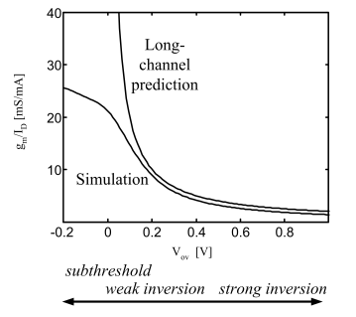
The Limitations of Vov-Based Design
The long-channel model is way too simple to make Vov based design reliable.
Evidence from SPICE vs. long-channel model:
  Real MOSFETs need more parameters in SPICE,
  not just μ and Cox.
  At large Vov , predictions are only ~25% off (acceptable).
  At small Vov predictions are completely wrong.
  At Vov=0V, the model falsely predicts infinite gm /ID .
  fT predictions are also inaccurate.
Subthreshold region ( Vov<0: negative region)
  Long-channel model says ID=0 → device "OF".
  SPICE shows gm/ID keeps increasing → useful for biasing.
  The subthreshold and weak inversion regions are very important in low-power designs.

Slide 15
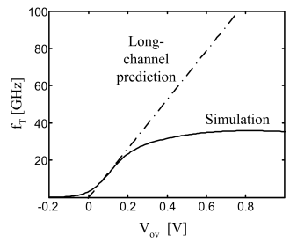
The tradeoff is explained by Ft vs Vov graph.
  Subthreshold devices are slower.
  In modern processes still fast enough for many low-power designs.
Vov is a nice concept, but it fails in practice because the long-channel model is inaccurate.
For low-power/subthreshold design, Vov-based design is useless.
gm/ID = simulation-driven, accurate, and practical for modern design.

Slide 16
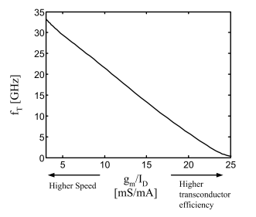
The gm/ID-Based Design Methodology
Why gm/ID is Better than Vov?
Vov is useful but messy
  To use Vov , you need two plots:
    gm/ID vs. Vov (efficiency)
    fT vs. Vov (speed)
  Then you must “guess” the best Vov .
gm/ID captures everything in one variable
  Vov and gm/ID are related, so we can ignore Vov .
  If we plot fT vs. gm/ID, we directly see:
    Higher efficiency → lower speed.
    Higher speed → lower efficiency.
  No “middle-man” Vov needed.
  gm/ID is the only biasing variable we will need.

Slide 17
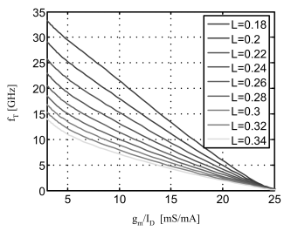
3. Subthreshold region is naturally included
  On the plot, the right-hand side (large gm/ID ) corresponds to subthreshold (very efficient, but slower).
  No need to worry exactly where subthreshold starts—gm/ID already tells us everything.
Designing with gm/ID - Example
We want Bandwidth = 600 MHz, Gain = 10, Low power.
gm = 10mA/V. ; Cgs (@ 500 MHz)= 1.1pF
fT= gm/Cgs = 9.4GHz. ; ID = 570μA.
gm/ID from chart (on the right) ; At fT=9.4 GHz = 17.5mS/mA.
The low power bias point found accurately using gm/ID
Effect of channel length L on transistor speed.
  For the same gm/ID, a longer channel length makes the transistor slower (low fT).
  Longer L improves output resistance ro – used in amplifiers as extra load.

Slide 18
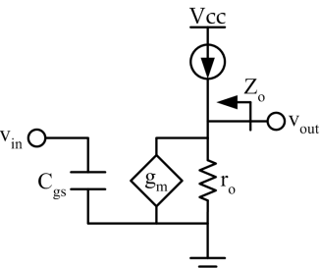
What about ro?
The figure : ro of a common-source amplifier appears as an additional load.
Ro is another load parallel to RL.
  If ro≫RL : the effect of ro is negligible, so gain = gm*RL (clean, predictable).
  If RL→∞: the only limit is the device itself → gain capped at intrinsic gain gmro. Aint =gm*ro
  Intrinsic gain gives the
  maximum voltage gain a transistor can provide.
Charts of fT vs. gm/ID and gmro vs. gm/ID together let designers pick the right L and bias.
A gain of 100 isn’t achievable with a single transistor, so we must use techniques like multiple stages or cascode, and the charts let us know this upfront without trial-and-error.
ro (and hence intrinsic gain) strongly depends on VD ; low headroom reduces gain.

Slide 19
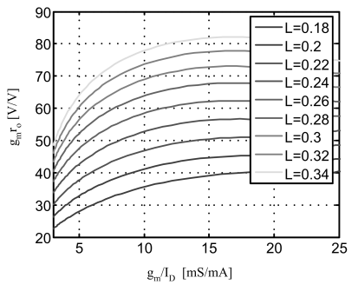
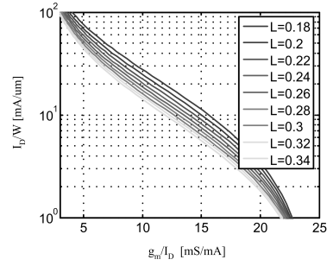
Biasing Using gm/ID
Charts of fT vs. gm/ID and gmro vs. Gm/ID
  They help you decide channel length (L) and gm/ID.
  L is chosen mainly for gain (gmro).
  gm/ID is chosen for speed (fT) and power efficiency.
Current (ID): Once gm is fixed from the gain requirement,
ID=gm/(gm/ID) is known
Width (W):
  You know L, ID and gm/ID.
  To physically bias the transistor at that operating point, you just need the right W.
  The ID/W biasing chart tells what W to choose for that gm/ID and ID.
Design charts → decide how the transistor should behave (performance).
Biasing chart → tells you what transistor size (W) to draw to achieve it.

Slide 20
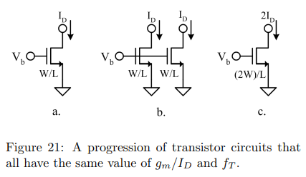
A Deeper Understanding of the gm/ID Method
Why does a specific value of gm/ID give us the same fT? Why does this work?
Intuition Behind gm/ID Method
Scaling doesn’t change ratios (gm/ID and fT)
  If you put transistors in parallel, both gm, ID, and Cgs scale up together.
  Since they scale proportionally, their ratios (gm/ID, gm/Cgs → fT) stay the same.
  That’s why fT and gm/ID don’t depend on W.
Notes:
Because paralleling MOSFETs is like increasing width W:
ID∝W → its like doubling the channel width; ID doubles
gm∝W → doubling W (paralleling) ; gm doubles
Cgs∝W→ Capacitance is proportional to gate area (W×L), so doubling W doubles Cgs.

Slide 21
2. Width (W) only scales values, not ratios.
  fT and gm/ID don’t depend on W (same as paralleling transistors).
3. Intrinsic gain behaves the same way
  In Parallel devices, gm doubles, but ro halves → intrinsic gain (gm*ro) stays the same.
  Hence intrinsic gain also depends only on gm/ID, not W.
4. Design convenience
If you take one transistor of width W, you can measure/simulate how gm, ID, Cgs, and ro behave as VGS changes.
The gm/ID method is powerful because transistor behavior scales linearly with width.
The plots of gm/ID vs fT or intrinsic gain don’t depend on W.
Expect within 10-20% anyway, because the final tweaks will be done in Spice.
And this is much closer than we can get trying to rely on the long-channel model.

Slide 22
Conclusion
gm/ID method links small-signal values (gm, fT) with device-level parameters (W, L, Vgs).
Captures tradeoffs (gain vs speed) and predicts results well.
Helps choose architecture early (knowing technology limits).
Can be automated (lookup tables + optimization engines).
Combines benefits of equations + simulations.

